Slide 1

A Data-Driven Flight Difficulty Score
Enhancing Operational Efficiency at ORD
United Airlines Hackathon Submission
By-The Avengers
Prince Kumar
Tarun Dhingra

Slide 2
Executive Summary
Top Recommedation
The Problem
Our solution
Key Finding
Nearly 50% of flights from ORD depart late, driven by inconsistent, experience-based resource planning
The Primary Drivers of Difficulty are extreme ground time pressure ad high volumes of transfer baggage
Proactivelly allocate specialized ground crews to the top 5% Difficult flights each day, starting with the STL route.
A daily Flight Difficulty Score that Systematically ranks every flight by its operational complexity

Slide 3
Key Findings from the Data
49.7%
621
3:1
Flight Depart Late
Flights Face a Bottleneck
Complex Transfer Hub
With an average delay of 21.2 minutes, widespread delays impact the entire operation
Scheduled with less than minimum turn around time, putting them at risk of delay from the start
The High ratio of Transfer bags to checked bags highlights immense pressure on baggage handling

Slide 4
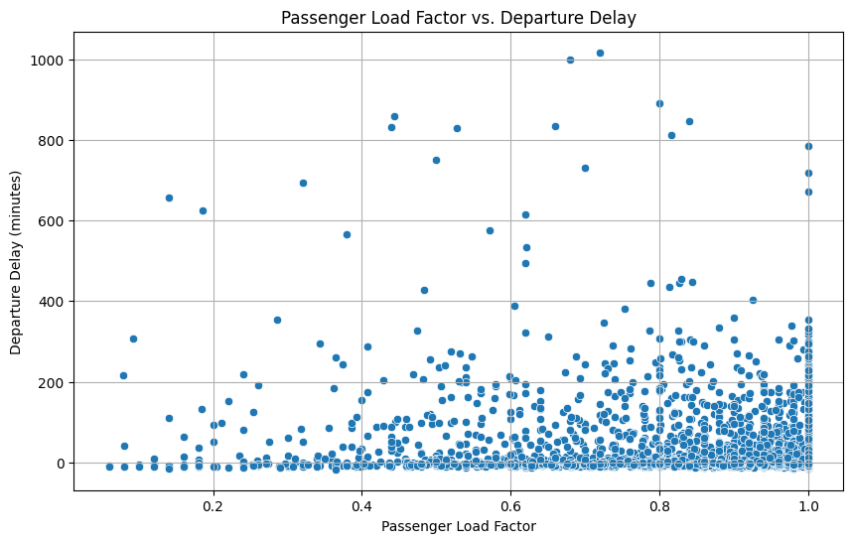
Surprising Insight: Fuller Flights Are Not Necessarily More Delayed
Key Insight
Analysis shows a weak negative correlation (-0.16), indicating that fuller flights are not a primary driver of delays on their own.
This suggests that while passenger volume matters (and is in our score), other factors like ground time and baggage are more critical predictors of difficulty.

Slide 5
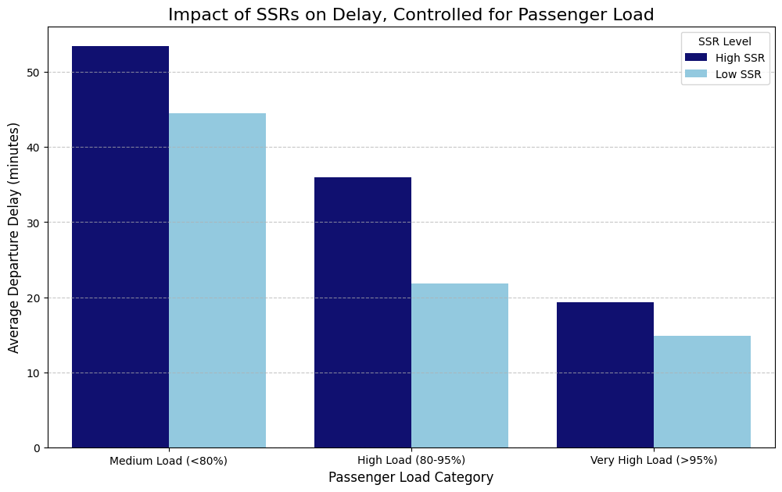
Key Driver: Special Service Requests Increase Delays at All Load Levels
Key Insight
After controlling for passenger load, flights with a High number of Special Service Requests (SSRs) are consistently more delayed.
This proves that specific passenger needs are a significant driver of operational complexity, independent of how full the flight is

Slide 6
Our Solution: The Flight Difficulty Score
We Developed a Weighted scoring model to quantify Operational Complexity. The score is calculated daily, allowing for dynamic resource allocation and then it classified into 3 categories (Difficult, Medium, Easy).
FEATURE | WEIGHT | RATIONALE
Ground Time Pressure | 30% | Our EDA Revealed this as a significant and direct operational constraint.
Transfer Bag Ratio | 20% | Reflects ORD’s complexity as a major hub and the labor required
SSR Count | 15% | Accounts for the extra time and coordination needed for passenger assistance.
Passenger Load Factor | 15% | Fuller Planes requires more time for boarding and deplaning.
Hot Transfer Bags | 10% | These time-sensitive bags and an extra layer of urgency and complexity.
Child & Lap Child Count | 10% | Accounts for additional boarding time and family needs

Slide 7
Analysis Deep Dive :Identifying the Hotspots
Top 10 Difficult Destinations
Airport | No. of Difficult Flights
STL | 88
DTW | 54
GRR | 53
DSM | 53
MSP | 51
DAY | 51
THE Story: Why STL is so Difficult
Flights to St.Louis are 44% more delayed than the airport average. Our Analysis reveals two clear reasons why
-51%
+50%
Less Ground Time Buffer
More Transfer Bags

Slide 8
Actionable Recommendations
1.Deploy a Turnaround Taskforce for STL
For the top 5 daily Difficult flights to STL, pre-assign an expanded ground crew to guarantee the aircraft is ready for boarding ahead of schedule, directly countering the -51% ground time pressure.
2.Implement a Priority Protocol
For STL-bound flights, baggage handlers should prioritize sorting and loading transfer bags first. Since these flights handle 50% more transfer, this targeted approach will reduce mishandled bags and departure delays.

Slide 9
Conclusion & Business Impact
From Reactive to
Proactive
Data-Driven Decisions
Expected Outcomes
This Score allows teams to anticipate and plan for difficulty before it happens, moving resources where they’ll be needed most.
This System Replaces inconsistent guesswork with a consistent, scalable and fair method for resources allocation across the airport
By Targeting the most Difficult Flights, we Expect to see improved on-time performance more efficient use of resources , and reduced employee Stress.

Slide 10
Appendix
https://github.com/prince22g/united_airlines_hackathon_final

Slide 11
Appendex A: Detailed Methodology
Data Integrity & Preparation
Data Aggregation: Merged five datasets (Flight, PNR, Bag, Remarks, Airport) to create a single flight-level view.
Data Cleaning: Handled missing values through mode imputation for airport country codes. Converted all date/time fields to a standardized format.
Duplicate Removal: Identified and removed 23 duplicate flight records using a composite key (flight number, departure time, and station) to ensure data integrity.
Feature Engineering: Created new metrics like ground_time_pressure, passenger_load_factor, and transfer_bag_ratio to quantify operational stress.

Slide 12
Appendex A: Detailed Methodology(Continue)
Feature Engineering
passenger_load_factor: The percentage of occupied seats on the aircraft (Total Passengers / Total Seats).
ground_time_pressure: The buffer time on the ground, calculated as scheduled ground time minus the minimum required turn time.
transfer_bag_ratio: The proportion of transfer bags relative to the total checked bags on the flight.
ssr_count: The total count of Special Service Requests (e.g., wheelchair) associated with a flight, aggregated from PNR remarks.
child & lap childcount:The total number of passengers classified as children and infants not occupying a seat, aggregated for each flight from PNR data.
hot transfer bag count:The total count of transfer bags with a tight connection time (less than 30 minutes), aggregated per flight.
Weight Selection
Weights were assigned based on our EDA findings. Ground Time Pressure and Transfer Bag Ratio received the highest weights as they showed the strongest connection to operational bottlenecks and delays during our initial analysis.

Slide 13
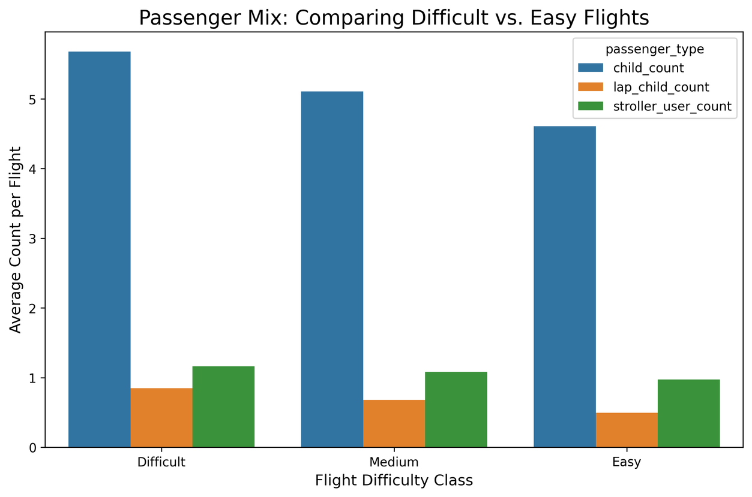
Appendex B: Chart: Passenger Mix on Difficult vs. Easy Flights
Insight
This chart shows that "Difficult" flights have more children, lap children, and stroller users than "Easy" flights. This supports using these passenger demographics to calculate a flight's difficulty score, as they increase operational complexity.

Slide 14
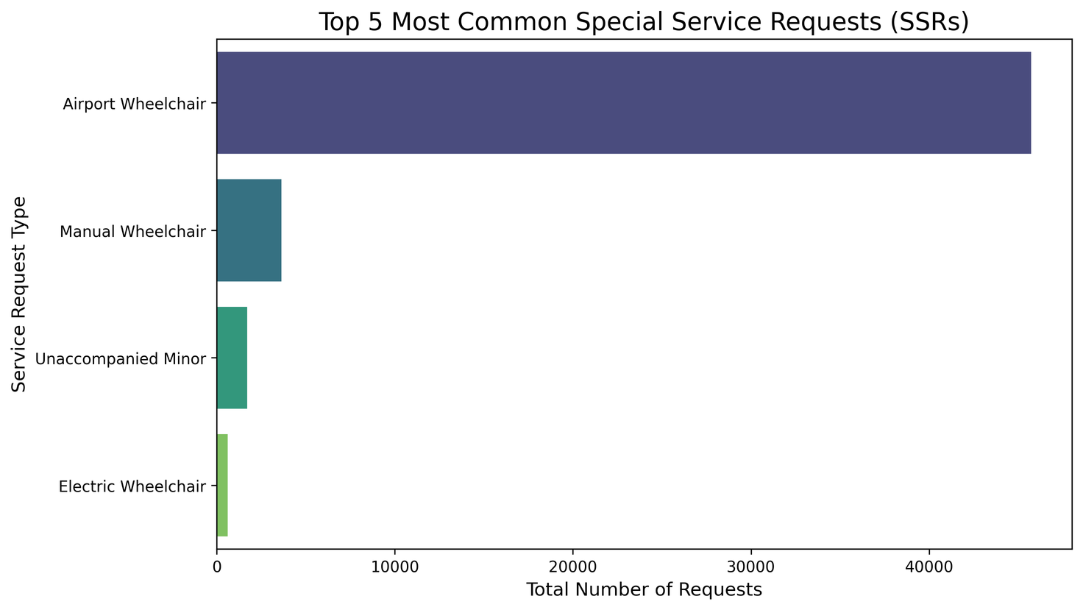
Appendex C: Chart: Top 5 Special Service Requests (SSRs)
Insight
This chart adds context to the ssr_count feature by breaking down the most common service requests.
It highlights that requests like "Airport Wheelchair" are highly frequent, which has a direct operational impact as it requires coordination of specialized staff and equipment, often impacting boarding and deplaning times.

Slide 15
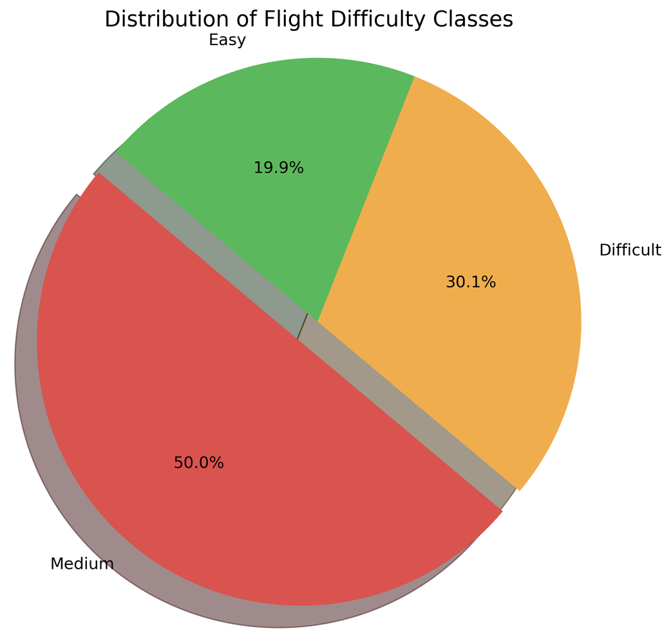
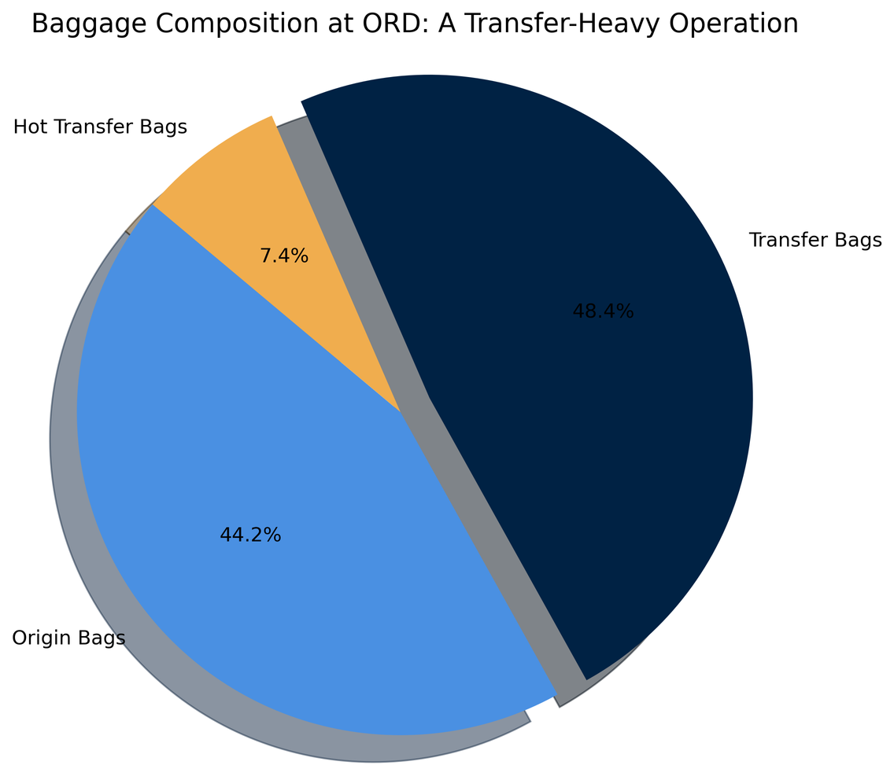
More Charts

Slide 16
Thank You

